Slide 1
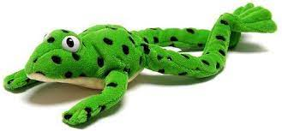
Phonics Screening

Slide 2
Reading Changes Everything
“Teach a child to read and keep that child reading and we will change everything… and I mean everything.”
Jeanette Winterson

Slide 3
What is the Phonics Screening Check?
A word-reading check taken in June.
Children read 40 words – 20 real words and 20 nonsense words, either by sight or using phonic strategies.
The check takes no more than 10 minutes and is done on a 1:1 basis.
The threshold is usually 32 words read correctly.
If they do not manage to read 32 of the words, they are given extra support, and repeat the check at the end of Year 2.
The aim is that all children will be able to read accurately before they begin Year 3.
All children are individuals, and all develop at different rates. The screening check ensures that teachers understand which children need extra help with phonic decoding.
They have not failed!

Slide 4

Green Words and Nonsense
(Alien) Words
Real Words
Nonsense Words
Words that can be read through decoding and blending.
Children are taught to segment and blend these words
These are real words that have meaning.
Examples of green words:
ch-o-p g-r-ee-n s-p-oi-l
c-o-b-w-e-b i-n-c-l-u-d-e
Words that can be read through decoding and blending.
Children are taught to segment and blend these words
These are not real words and have no meaning.
Examples of nonsense words:
j-o-ch r-ee-nk l-i-p-e
b-r-ai-n-t s-r-i-nk-er

Slide 5

How are the results used?
Results from the check will be used by schools to analyse their own performance and for Ofsted to use in inspections.
Teachers will gain a better understanding of who needs support with decoding/blending.
Parents will have an understanding of whether their child is on track with their reading skills (results will be shared with parents in end of year reports).

Slide 6
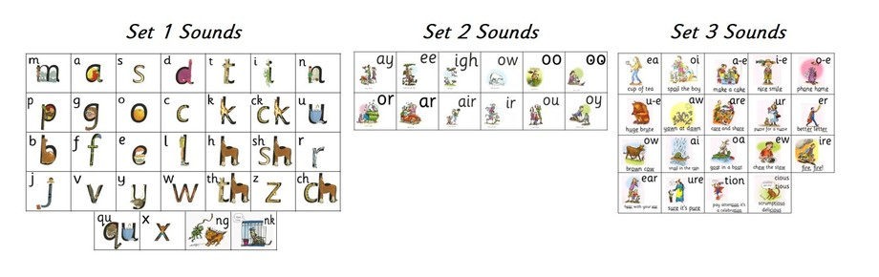
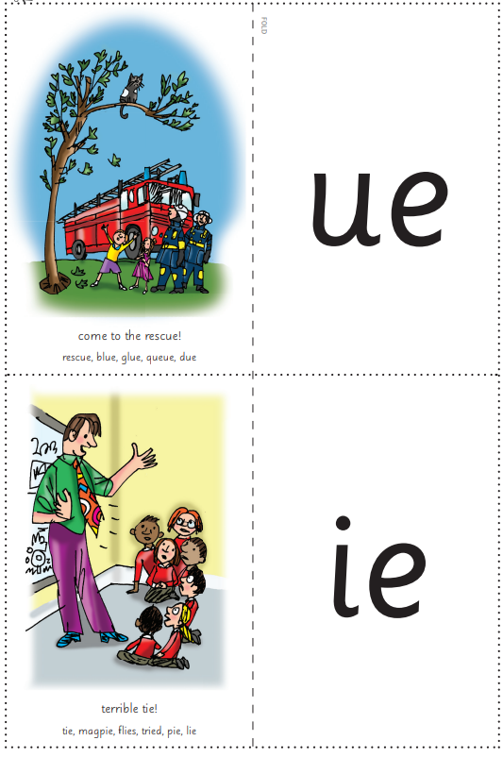
What Can You Do To Help?
Listen to your child read everyday. This can be a book of their choice, but the more they read, the more exposure they are gaining!
Regularly practise set 1, 2, 3 and the additional sounds, in a different order each time. Remind your child to say the pure sounds…
When a support booklet comes home, encourage your child to read the words (this can be done in any order!).
Encourage your child to read books with confidence and pace.

Slide 7
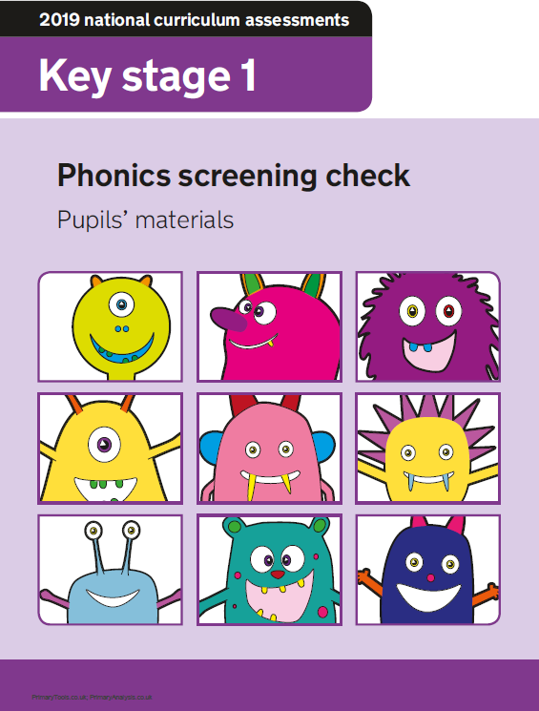

Questions?

